Slide 1


Reading in KS2 at Navenby

Slide 2

Why is reading so important?
The ability to read fluently and with meaning develops and enhances many skills, including:
Vocabulary (one of our school’s key drivers)
Grammar
Pronunciation
Memory
Communication
Imagination
Knowledge and understanding of the world
Attention span
Calming for personal well-being

Slide 3

Opportunities for reading in KS2:
- Guided reading sessions
Whole-class reading sessions
WAGOLLs in English lessons
Reading across different curriculum subjects
Class novels shared daily
Time for independent reading
Reading segment of our daily ‘Active English’ warm-up

Slide 4
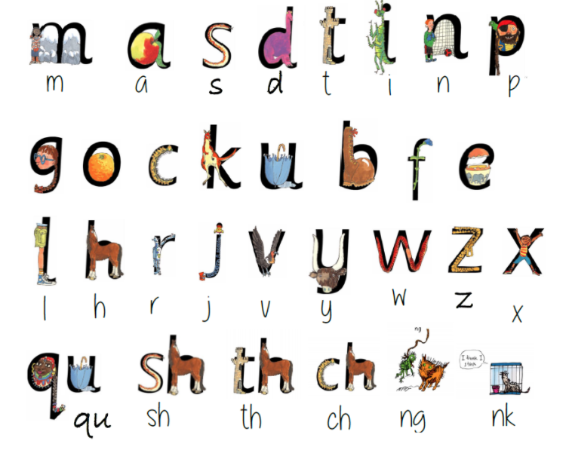
How do we teach reading at Navenby?
ReadWriteInc phonics from Reception – Year 2 to teach the skill of reading by decoding print
Then focus on the ability to understand and make meaning from the printed word
Why do you think…?
What can you conclude about…?
Predict what might happen if….
Why has the author used this particular word?

Slide 5
Guided Reading: Key Principles
Encourage children to become autonomous, enthusiastic and thoughtful readers
Groups of children of a similar reading ability working together to unpick a text

Slide 6
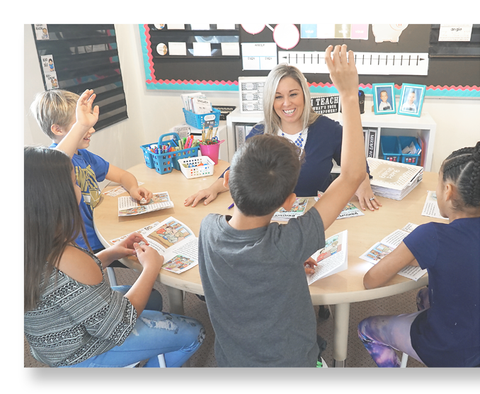
Guided Reading: In Practice
The teacher hears the children read and encourages a specific fluency skill such as expression, intonation or pace
The teacher asks questions to promote discussion with the children to extend their understanding and response to the text
The children contribute to the discussion, developing their listening skills
The children learn from each other and take increased responsibility for their learning
The teacher monitors and records the children’s progress to inform future planning and targets

Slide 7
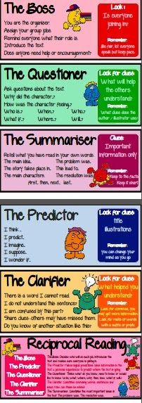
Guided Reading: A sample Year 3/4 session
Reciprocal Reading

Slide 8
Guided Reading: A sample Year 5/6 session
1940.
It started as any other ordinary evening - if you could call bombings, air-raid sirens, rationing and devastation ordinary, that is. When the piercing wail of the air-raid sirens filled the skies, we knew exactly what to do. We may have been living through the Blitz, but for us, this life was ordinary - we didn’t know any different.
At five o’clock I stood at my window and watched the nondescript street below. The occasional car whizzed past and children clung to their mother’s skirts as they rushed to be indoors before night shrouded the streets in its velvet blanket. Above the rooftops of the houses across the road, darkness seemed to rise in a fury. It quickly became apparent that it wasn’t night that was approaching, but a thick, black smoke which rapidly filled the air and consumed everything within its reach. Fire. Burning. Something was wrong.
Before long, the ominous screech of air-raid sirens filled the air. How I hated that persistent, undulating sound which brought with it a hideous sense of foreboding.
Define the meaning of the following words in the text, using the context of the story:
Nondescript
Shrouded
Ominous
What does the author mean when they write ‘darkness seemed to rise in fury’ (paragraph 2)?
How can you tell from paragraph 1 that the siren sound is familiar to the writer?
In paragraph 2, which action shows us that the children are scared?
How old do you think the person retelling the story is? Use evidence from the text to support you answer.

Slide 9
Whole-Class Reading: Key Principles
There is one learning objective for the whole class, based around the same age-related text. Questions may be adapted slightly for different abilities so that all children can access the learning objective and be challenged, or quite often pictures or film clips will be used for this instead of text so that it is accessible for all.
Texts / images / film clips can be linked to the half termly topic e.g. WWII, but in order to get a wide variety of genres, we select from poetry, fiction, non-fiction and stories from other cultures.
Pobble – Example Lesson The Hidden Temple

Slide 10
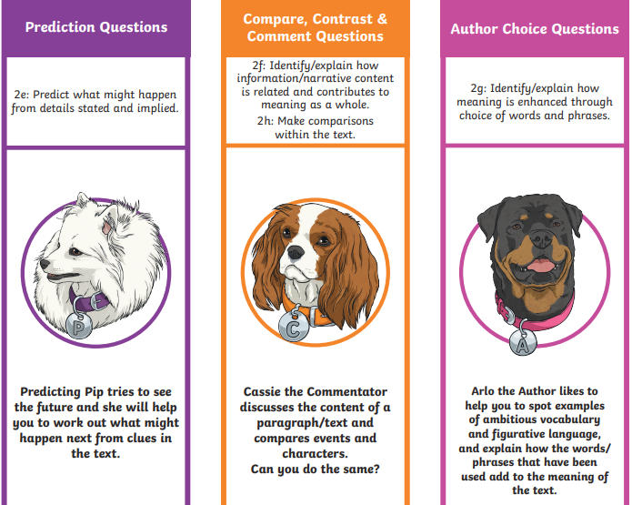
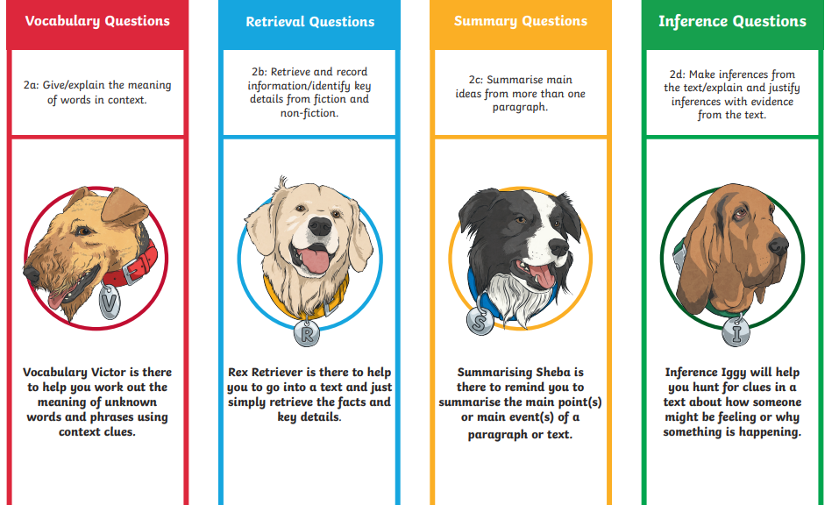
KS2 Reading Skills

Slide 11
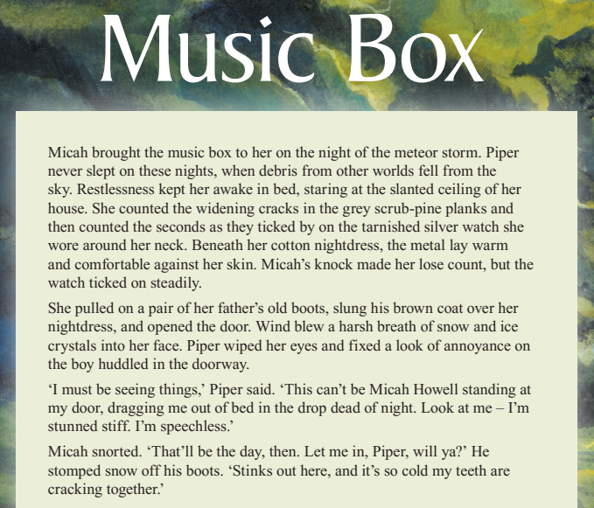

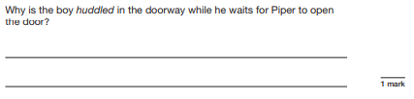
End of Year 6 – What are we aiming for?
The Year 6 end of KS2 Reading SATs paper assesses children’s skills in reading. Here’s a short sample from 2019’s reading paper:

Slide 12
Helping with reading at home
Choose a quiet time
Make it an enjoyable, positive experience
Children need to feel successful, reading around 95% of the words comfortably
Visit the local library
Little and often is just as valuable
Talk to your children about the books they’re reading
Read to your child – they’re never too old!

Slide 13
Questions to ask at home
Do you like this book; why?
Who is your favourite character?
Tell me about a character in the book.
Which words tell you what the character is like?
How would you feel?
What do you think will happen next?
What would you do?
What have you learned about …… in your book?
What can you tell me about…?

Slide 14
Questions to extend learning
- Finding information on the page
- Being able to find information that is not on the page
- Thinking about situations and predicting what might happen
- Putting yourself in a character’s shoes and understanding what is going on from their viewpoint

Slide 15
Resources to help at home:
Read Theory
https://readtheory.org/
This is a FREE online comprehension tool which has variety of short texts with multiple choice answers. The computer marks the answers.
https://misterbodd.wordpress.com
No Shelf Control Blog by Mister Bodd
A great blog kept by a KS1 teacher who makes lots of great book recommendations for children of all ages!
https://schoolreadinglist.co.uk/category/reading-lists-for-primary-school-pupils/
Primary School Reading Lists for Children aged 3-11
The School Reading List regularly update their recommendation of novels for children of all ages!
BooksForTopics
https://www.booksfortopics.com/
A great website linking you to excellent books on all manner of genres to help your children stay hooked into their school learning topics!

